Slide 1
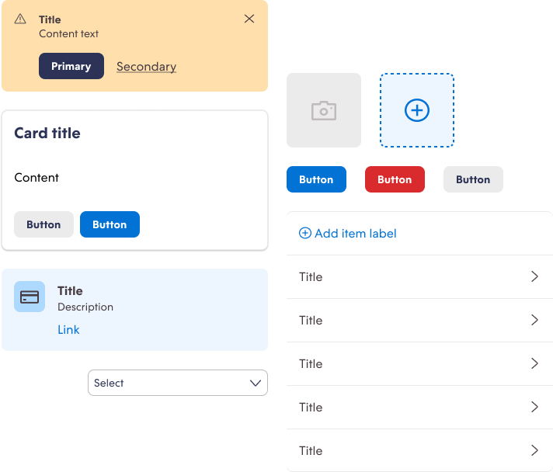

Nimbus Design System
2021-22

Slide 2
Context
Today I am responsible for the product design system at Nuvemshop. This product called Nimbus is intended primarily for internal teams and also for external partners who want to integrate into our ecosystem. Several Nuvemshop applications are using or are planning to use this design system as a way to enhance delivery.
Today we have a team dedicated to the design system: an engineering manager who leads the team along with myself, two senior product designers and a front-end developer specialized in design systems.
Highlights
Desktop and mobile applications using this design system
Focused on internal teams and partners
Support the new branding strategy
Design team: 4 people, 1 of them focused in this initiative
Notes:
contexto:
time core
quantos usuários no aplicativo
tempo sem mexer no app
time responsável

Slide 3
Context
A Design System Isn't a Project. It's a Product, Serving Products. (Nathan Curtis)
We had several barriers to the creation of this design system. Personally, I came into this project when it had already started and was faced with challenges of product vision and design and dev directions.
An important approach for the Nimbus team is to look at our DS as a product by itself. Looking in this way, we understand who our users are, what their needs are, what we need to prioritize for them and what metrics we should track to evaluate our impact and success.

Slide 4
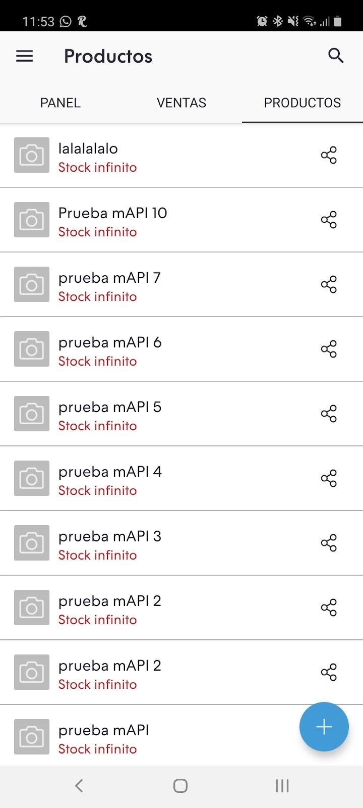
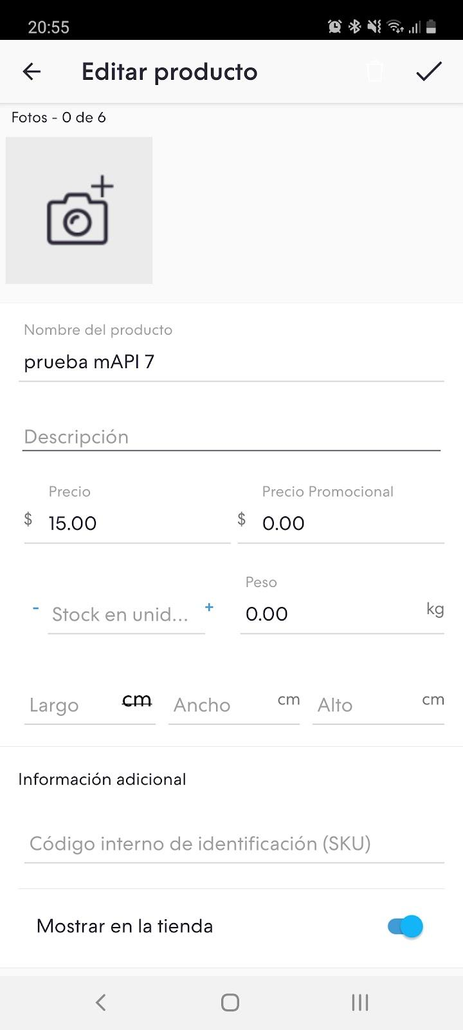
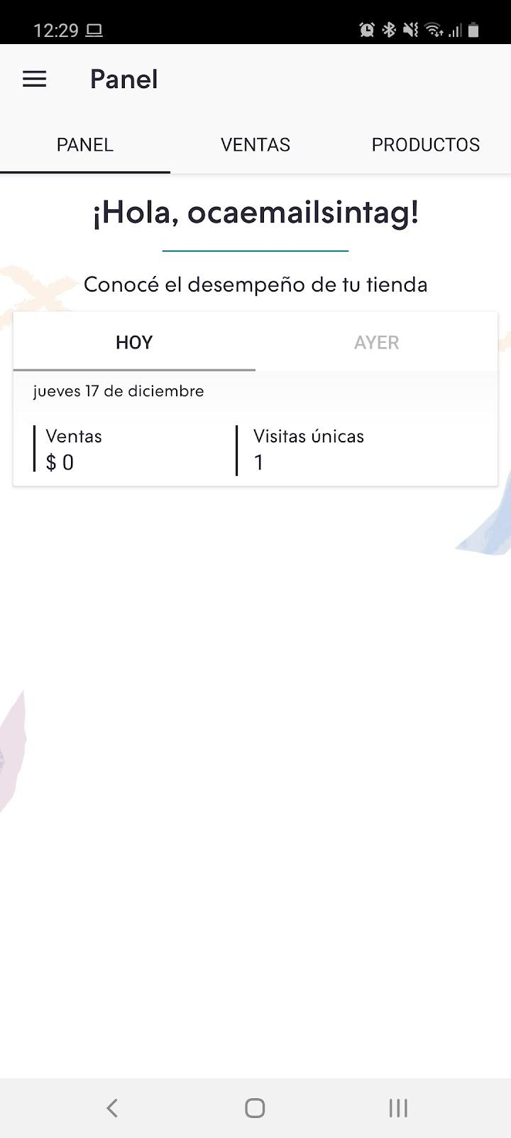
Challenge
How to implement the new brand definitions in a scalable way?
To kick-start our design system, we chose to create it together with our mobile app redesign. To give context, it was a native app developed for Android and iOS that hadn't been updated in a few years. In addition, it had a gap in functionality compared to the desktop experience and had an old application of our brand.
We chose this approach because we wanted to ensure that DS would have a real use case from the start and the components created would actually be useful for the redesign.
Notes:
desafio
como engajar o usuário no app e apresentar para ele a nova "marca"?

Slide 5
Project goals
1.
Update visual and usability in line with the new brand definitions
2.
Boosting the scalability of the new mobile app
3.
Create design and dev basis for other applications and products
Notes:
objetivos
fazer o update do app
trazer o visual para a nova marca
habilitar a escalabilidade do produto

Slide 6







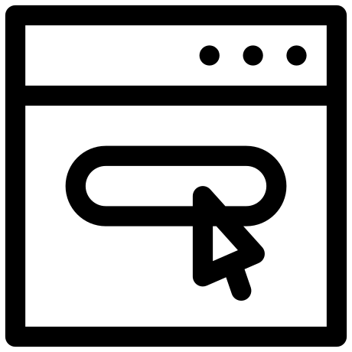
Process
We separated the process in two tracks. One track was related to the application redesign, and another track was related to the creation of the design system. At the beginning of the project, we didn't have a dedicated DS team, so the design and dev activities were performed by the same team. After the initial discovery of the redesign and the DS, the redesign project was separated in several smaller parts developed in a cycle.
Problem
Discovery
Creative sessions
Design
Prototype
Hand over to built
APP REDESIGN
DESIGN SYSTEM
Discovery
Design exploration
Component craft (design + dev)
Release
Notes:
Problem
Discovery
- Discovery
Creative sessions
Design
- Identify a new component need
- Design exploration
- Component craft
- Release
Prototype
Hand-over to built

Slide 7








Discovery
As it was the first time we were investing in building a design system, so we did extensive and thorough research on what were the best market practices, most common structures and most common used technologies.
We drew on other recognised design systems to give us a benchmark of what we needed to do to have a world-class DS.
Benchmark
Foundations
Principles
Tech and design needs
Tokens definitions: colors, typography, spacing…
Structure
Notes:
Benchmark
Foundations
- princípios
- tech and design needs
- definições de tokens: cores, tipografia, espaçamentos

Slide 8
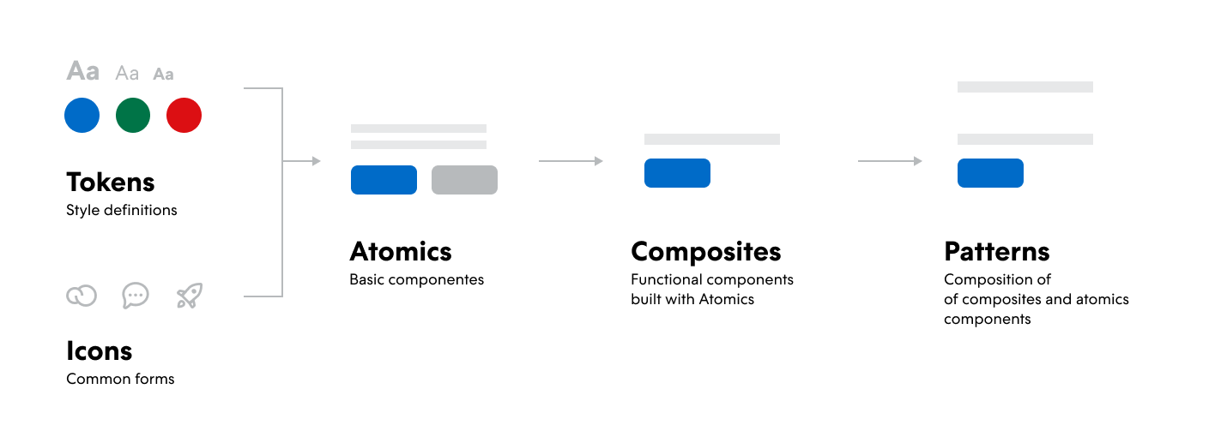
Discovery
Structure
Notes:
Benchmark
Foundations
- princípios
- tech and design needs
- definições de tokens: cores, tipografia, espaçamentos

Slide 9
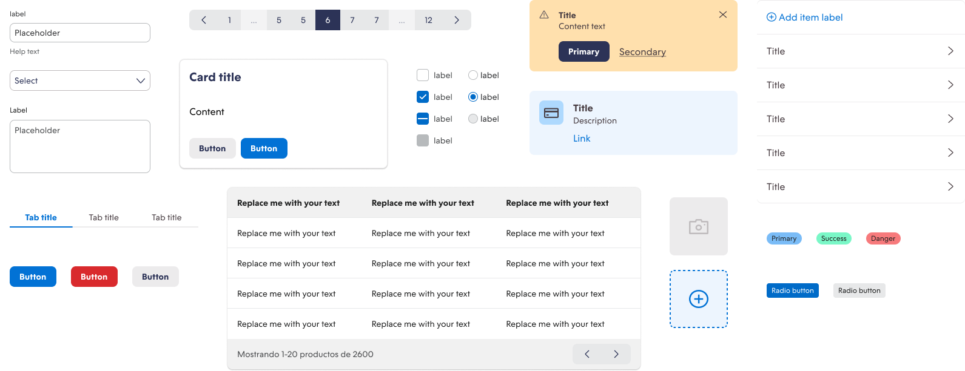
Execution

Slide 10
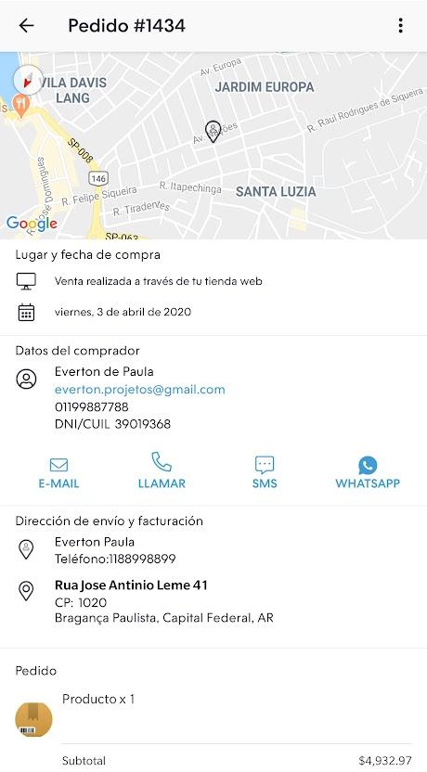
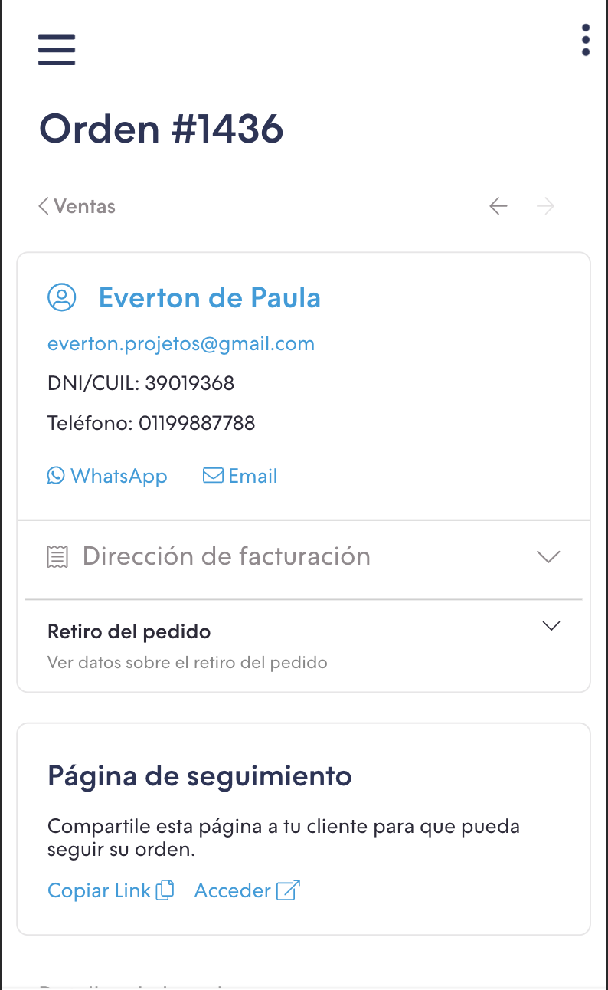
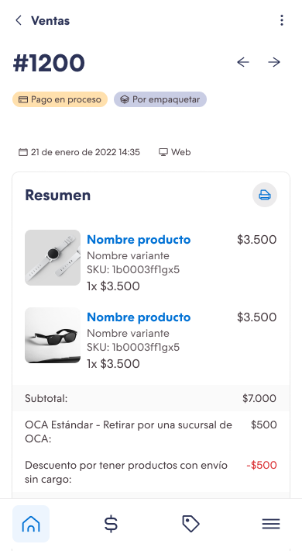
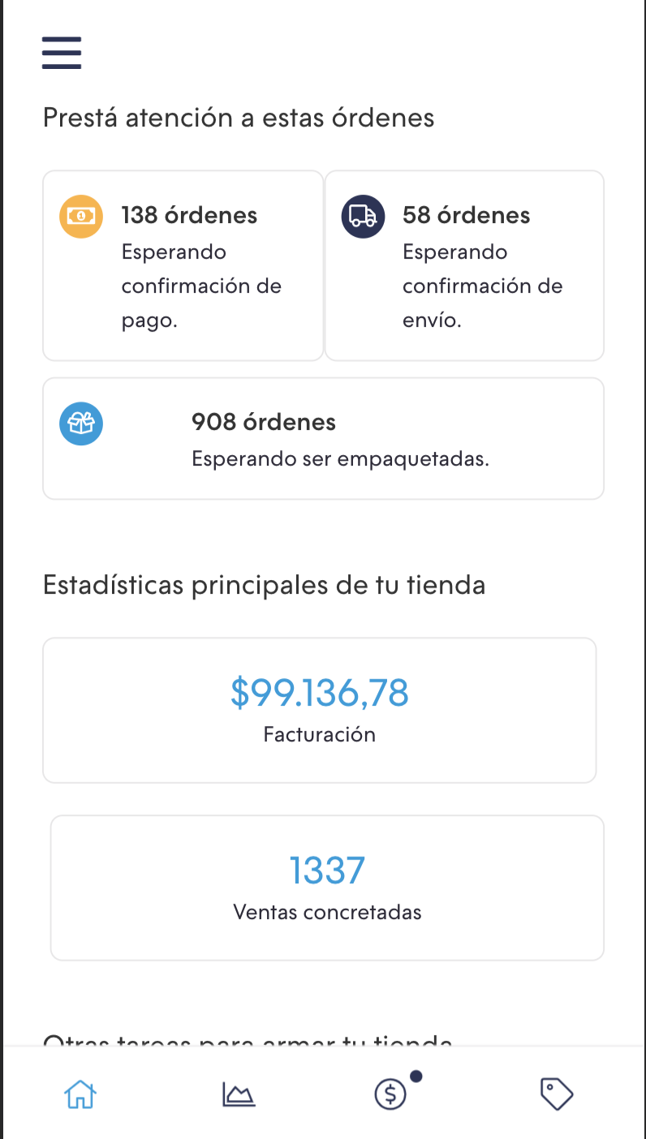
Execution
ORDER: OLD MOBILE
ORDER: DESKTOP RESPONSIVE
ORDER: NEW MOBILE

Slide 11
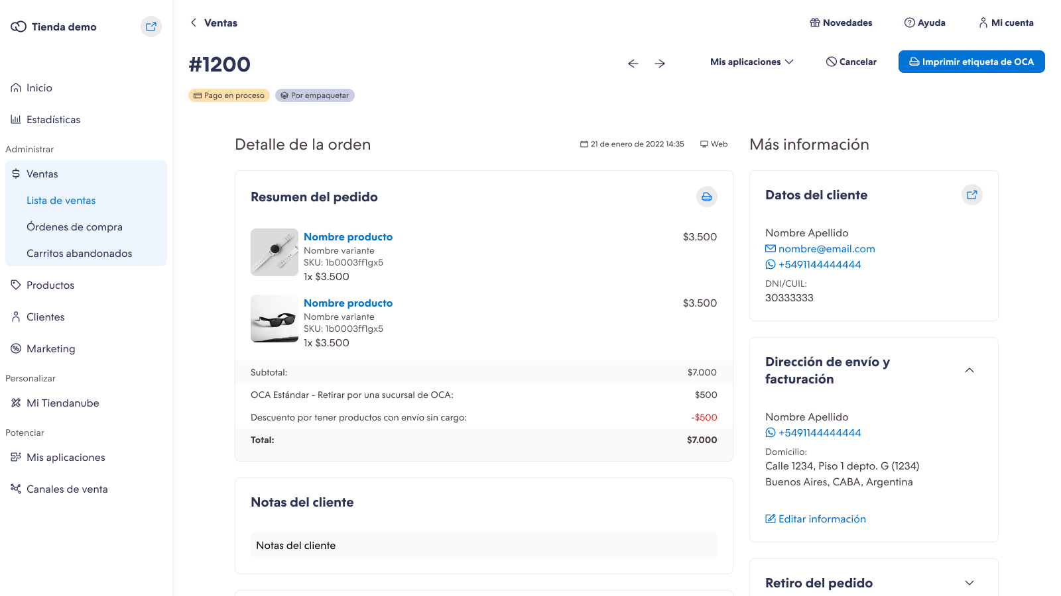
Execution
ORDER: MOBILE
ORDER: DESKTOP

Slide 12
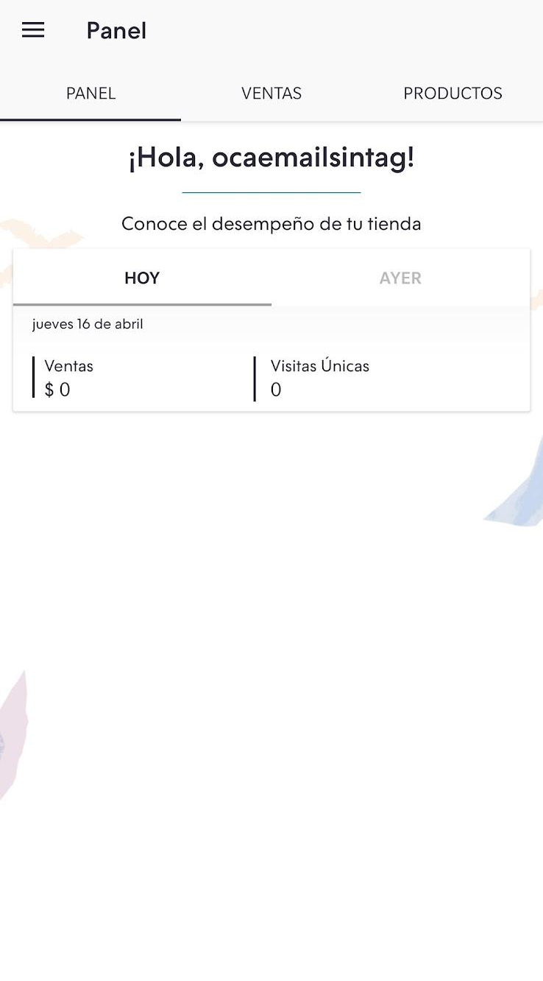
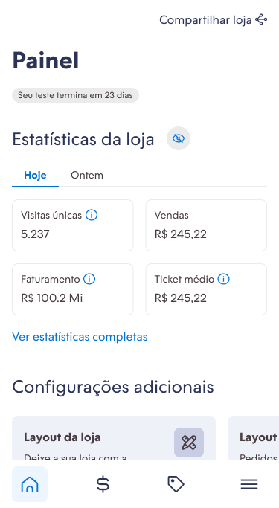
Execution
DASHBOARD: OLD MOBILE
DASHBOARD: DESKTOP RESPONSIVE
DASHBOARD: NEW MOBILE

Slide 13
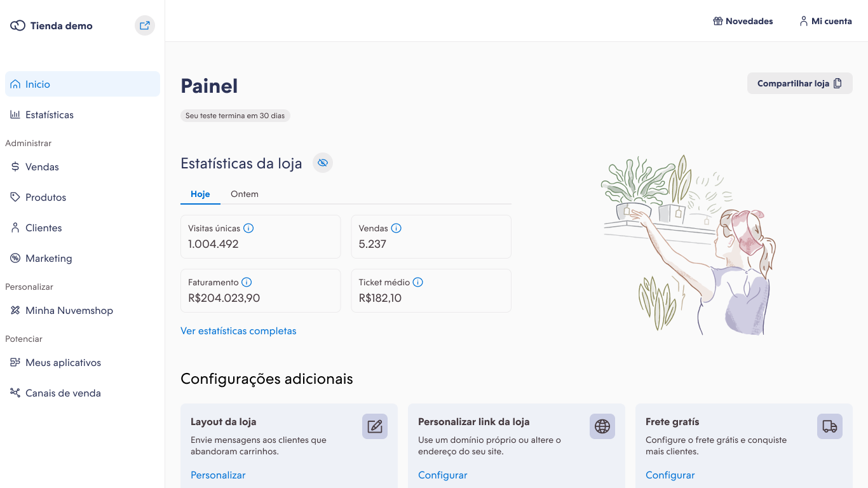
Execution
DASHBOARD: MOBILE
DASHBOARD: DESKTOP

Slide 14
Results
+40 atomic components, compounds components and patterns
13 applications, mobile and desktop, using the design system
Dedicated team of 2 designers and 1 dev to improve and evolve the DS
The redesign project isn't over yet, but so far we have a big number of components created, among atomic, composites and patterns, within the app redesign cycles.
At the moment, we have 4 different teams using our design system, without adoption issues. This is generating a lot of learning and opportunities for improvement.
As DS usage escalated, we were able to justify the need to have a dedicated team with designers and front-end devs. This was very important for us to have focus and also pace of delivery.
Notes:
Trazer resultado final em termos de entrega
48 componentes criados
4 aplicações utilizando
trazer 2 métricas aqui:
coverage
appstore

Slide 15
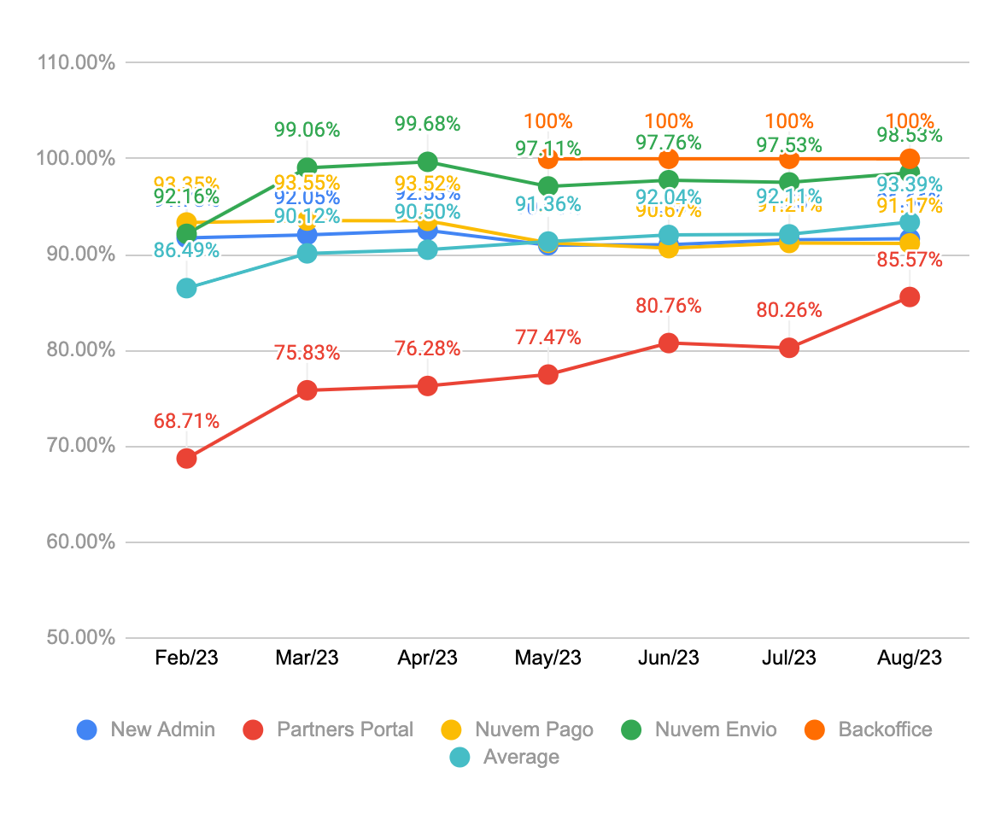
Results
Coverage:
how many % of the front-end of the application is Nimbus?
To find out if our DS was meeting the needs of the teams, we created a metric that semi-automatically measures how many % of the front-end of the applications are Nimbus and how many % are other custom components. The goal is to be above 90% on average.
Notes:
Trazer resultado final em termos de entrega
48 componentes criados
4 aplicações utilizando
trazer 2 métricas aqui:
coverage
appstore

Slide 16
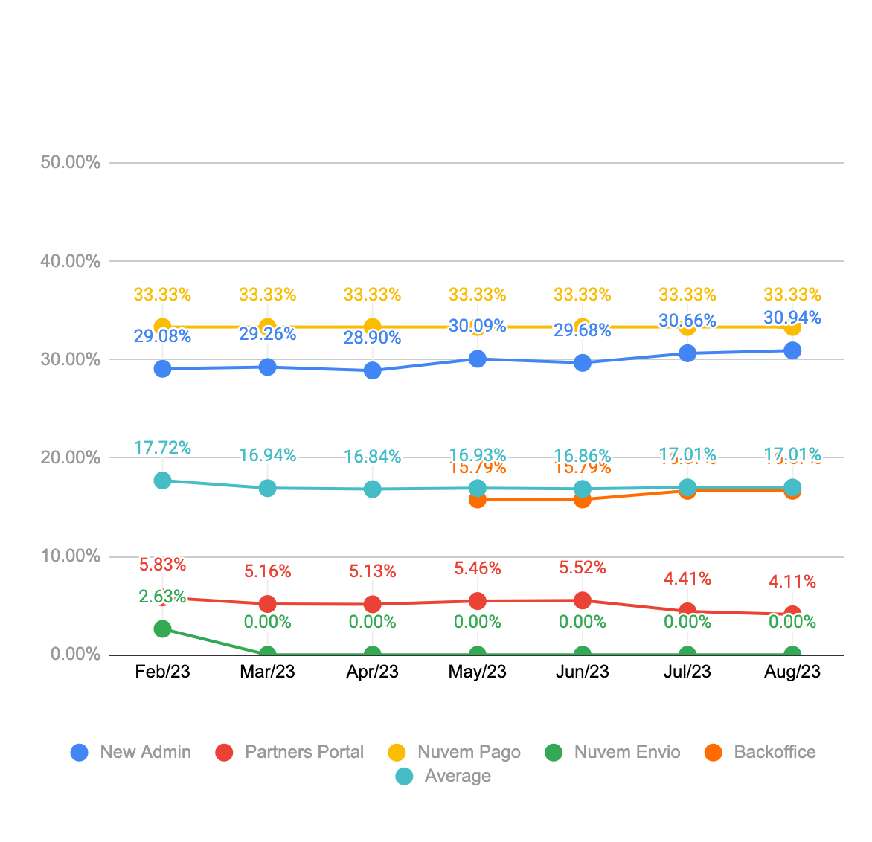
Results
Overrides:
how many % of the components used were customised?
Along with the Coverage metric, we created the Overrides metric, which measures how many % of the used components of our design system have been customized or modified inside de applications. The goal is to be below 10%.
With these two metrics, we were able to identify opportunities to meet the needs of the teams and keep a more accurate track of Nimbus adoption.
Notes:
Trazer resultado final em termos de entrega
48 componentes criados
4 aplicações utilizando
trazer 2 métricas aqui:
coverage
appstore

Slide 17
Learnings
Understanding better what impact Nimbus has on our end users' experience
Raising the bar on design and code quality from the start
Digging deeper into the information generated by the metrics
We are revisiting components that were created at the beginning of the project as we learn from the process, and have new ways of building components that are more flexible and easier to use.
The information generated from the metrics is very rich as it gives visibility into which use cases our DS is not meeting and where we need to improve to increase Nimbus adoption.
We are collecting feedback together with the teams on how our end users are receiving the new interfaces. This will be very important in helping us prioritise improvements.

Slide 18
Thanks!
https://nimbus.nuvemshop.com.br/

